Slide 1

Electronic Workshop Project
Electronic Stethoscope

Slide 2
PROJECT DESCRIPTION
Electronic Stethoscope is an audio amplifier that uses physical amplification.
The stethoscope basically receives the input of our heartbeat, forwards it to the microphone circuit, which is further connected to the amplifier circuit, then we connect it to the low pass filter circuit to remove noise, after that we connect it to the audio amplifier circuit which is further connected to the speaker and we can then observe the amplified version of our heartbeat in a waveform which will be displayed on the oscilloscope and listen to it via speaker.

Slide 3
COMPONENTS REQUIRED
• Resistors 1 k ohm and 100 k ohm
• Capacitors 1uF , 2 100uF, 1 1000uF, 2 4.7uF
• Breadboard(s)
• Connecting wires
• Amplifier LF 353 or alternative
• Power supply
• Resistors two 10 k ohm
• Electret Microphone
• Oscilloscope
• Function Generator
• Speaker
• LM 386 Audio Amplifier

Slide 4
PROJECT PROCEDURE
The idea of the project is to take the input of the heartbeat and listen it via speaker.
-We firstly connect the microphone to the electronic stethoscope and design the corresponding microphone circuit and verify it's working on the oscilloscope.
-Then we design an amplifier circuit and verify it's working. After verification, the microphone circuit is connected to the amplifier circuit.
-After this we make a low pass filter circuit to remove the sound of unwanted high frequencies( basically noise).
-Further, an audio amplifier circuit is designed to amplify the frequency of the input heartbeat and listen to it using speaker.

Slide 5
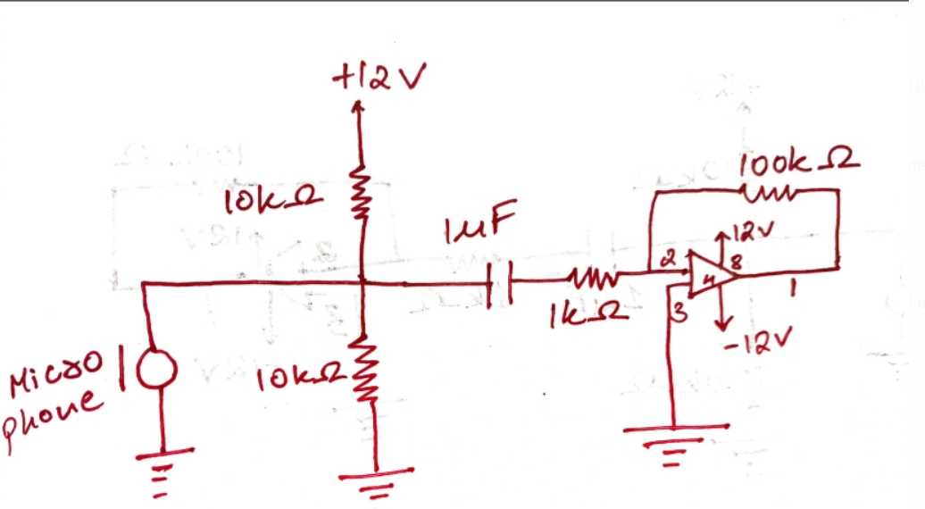
CIRCUIT DIAGRAM

Slide 6
Timeline For The Project
Task List | Required Time | Final Date
Project Proposal Presentation | 5 minutes | 23/01/2023
Electronic Hardware Design | 1 day, approx 3 Hrs
Microphone circuit | 1 hr
Amplifier circuit | 1 hr
Connecting the circuit | ½ hr
Final Amplification & Mid Evaluations | 1.5 hr | 30/01/2023
Final Presentation |  | 13/02/2023 or before if possible

Slide 7
Team Members:- The Euphoria in Electronics
Kripi Singla(2022102063)
Janya Gupta(2022102033)
(Table No. 2)

